Slide 1

Voter Registration
Toshia H. Brown
Bureau of Voter Registration Services
Division of Elections
March 23, 2021

Slide 2

Data Entry
Governing Provisions
Initial Search
Fields
Acceptance or Denial

Slide 3
Governing Provisions
  Section 97.053, Fla. Stat.
    No later than 13 days after date of receipt
  Rule 1S-2.039, Florida Administrative Code
    Data entry rules
  Division of Elections – forwards all received voter registration applications to the Supervisor of Election’s office.

Slide 4
Data Entry – Initial Search
  Conduct existing record search (e.g., 1st and last name, last name and date of birth, 1st name and date of birth, driver’s license only, etc.)
  If one or more records found,
    Registration date on more recent record before January 1, 2006:
      Remove the older registration record in the FVRS.
      Update more recent record to be the voter’s active registration record.
      Assign a code in the FVRS to reflect the basis for removal of older record as duplicate registration record.
    Registration date on more recent record is on or after January 1, 2006:
      Update older registration record with the newer county of residence information in the newer record.
      Update record with the information from the application.

Slide 5
Data Entry – Fields
  Name
    At least one name required (if known by only one name-last name field)
    Enter printed name
  Date of birth (month, day, year)
  Legal Residence (no mailing or business address)
  Physical presence at address at which someone intends to make his or her permanent residence as evidenced by certain activities.
  Shelter where a homeless person resides.
  Address of place where person docks his or her houseboat.
  (Refer to Division of Elections Voter Residency Guidelines for Florida)

Slide 6
Data Entry – Fields
Date signed (not required)
Signature (required)
  Original signature of the applicant on paper application. (Exception: DHSMV digital signature image for electronic records)
  No one other than applicant’s signature – a parent, person with power of attorney or guardian does not have authority to sign a registration form for another.
  A person can sign with an “X” or other mark if that is all his or she is capable of due to a physical disability or that is the way the person always signs his or her signature. (no rubber stamp)

Slide 7
Data Entry – Fields (cont’d)
  Check boxes for eligibility (required)
    U.S. Citizenship. (permanent legal resident is not a U.S. Citizen)
    Non-felon or if convicted felon with rights removed, rights have since been restored. (this check box field is not on FPCA or federal/national mail-in application)
    Non-adjudication of mental incapacity or if mentally adjudicated incapacitated and voting right removed but rights restored. (this check box field is not on FPCA or federal mail-in application)

Slide 8
Data Entry – Fields (cont’d)
  New applicant says he or she has no Personal Identifying Number
DHSMV/SSA
Verifies that no PIN found
DHSMV/SSA Verifies that PIN found
New applicant becomes new registered voter
SOE sends Notice to ‘Unverified Applicant’
New applicant provides proof of PIN
Do not resubmit PIN for DHSMV/SSA verification
Change PIN source from F for form to P for proof
New applicant becomes new registered voter
Must provide special ID sometime before voting
Exception for vote-by-mail voting: (i.e., UOCAVA voter, 65 or older, or with temporary or permanent disability, but must execute affidavit for ballot to count.
Record flagged as Special class: Mail-in ReGistrant Voter

Slide 9
Data Entry – Fields (Cont’d)
  Do not send record if application is incomplete
  Personal identifying number provided on new application
DHSMV/SSA Verified
Neither DHSMV or BVRS is able to verify number
Unverifiable
BVRS Verified
Verified that number exists for that person
BVRS is able to verify number with DHSMV records
New applicant becomes new registered voter
SOE sends Notice to ‘Unverified Voter’
New applicant must provide proof of PIN
If proof provided, do not resubmit PIN for DHSMV/SSA verification
Change PIN source from F for form to P for proof
New applicant becomes new registered voter
New applicant becomes new registered voter

Slide 10
Determination – Accept or Deny
  Supervisor’s sole authority to accept or deny registration application
  (s. 98.045, F.S.)
  Based 4 corners of the application--no proof required to be submitted with application
  “Complete” application becomes the official voter registration record upon receipt of all information necessary (on application) to establish the applicant’s eligibility per s. 97.041 and verification of personal identifying number (PIN) is verified pursuant to subsection (6) or nonexistence thereof.
  Notice to voter about status of application within 5 days after it is entered
  Incomplete
  Denied
  Accepted (voter information card), or
  Duplicate of an existing registration (minimum- signature update)

Slide 11
Driver and Vehicle Information Database (DAVID)
DAVID MOU
DAVID Sensitive Data
DAVID Personal Information
DAVID Benefits

Slide 12
DAVID MOU
  If your county wishes to gain access to FLHSMV Data. A Memorandum of Understanding (MOU) is required to be in place before access is given to your county.
The first set of forms provide the specific need and use of the data you are requesting access for and pertinent information regarding your county.
For assistance in obtaining access please reach out to the following DSHMV contact: datalistingunit@flhsmv.gov This is the data listing unit that can provide assistance in gaining access to DAVID.
The forms will then be reviewed for approval to provide your county with an agency agreement (MOU). Reference: R1S-2.048, Florida Administrative Code

Slide 13
DAVID Sensitive Data
  All data contained within the DAVID system is sensitive and privileged information and shall be handled accordingly. To maintain the integrity of this information, the records will be accorded proper management and security, and will only be accessed and used by authorized personnel in accordance with state and federal law.
  Activity associated with any aspect of the DAVID system is subject to detailed monitoring and audits to protect against improper or unauthorized use. Unauthorized use includes, but is not limited to, queries not related to a legitimate business purpose, personal use, dissemination, sharing, copying or passing of DAVID information to unauthorized users and could result in civil proceedings against the offending agency and/or criminal proceedings against any user or other person involved.
  Violations or misuse may also subject the user and the user's agency to administrative sanctions and possible disciplinary action by their agency, and could result in DAVID access termination.

Slide 14
DAVID Personal Information
The Driver’s Privacy Protection Act, 18 United States Code sections 2721(“DPPA”) makes personal information contained in motor vehicle or driver license records confidential and exempt from disclosure.
Personal information in a motor vehicle or driver license record includes, but is not limited to, an individual’s social security number, driver license or identification number, name, address etc. Personal information does not include information related to driving violations and driver status. Personal information from these records may only be released to individuals or organizations that qualify under one of the exemptions provided in DPPA, which are listed on the back of this form.

Slide 15
DAVID Benefits
County initiated eligibility case files.
Data entry of voter registration applications.
DOS eligibility case files.
Death matches.
HSMV Verifications.

Slide 16
Voter Registration Exemptions
Categories of Exemptions
High-Risk Professionals
Applying Exemption Flag

Slide 17
Applicable Exemptions (not exhaustive)
  Social security number (s. 97.0585, F.S., s. 119.071(5), F.S.)
  Florida driver license number/Florida identification number
  Where a person registered to vote or updated his or her voter registration
  Signature [may be inspected only]
  Information as to whether the person declined to register to vote
  ACP Participant/Voter
  Certain high-risk professionals with statutory right to exemption for personal identifying information upon written request (Section 119.071(4)(d), F.S.)

Slide 18
High-Risk Professionals
Judges, state attorneys, guardians ad litem, child abuse investigators, law enforcement officers, correction officers, firefighters, human resource personnel, etc. including their spouses and children and victims of aggravated violent crimes.
An applicant must still submit residential address for proper voting precinct assignment.
Requires written request directed to each agency that has a record with the person’s address.
Residential address, phone number, date of birth, photos, etc. in public records are exempted from public disclosure. See e.g., section 119.071(2)(j), (4)(d), and (5)(i), Fla. Stat.

Slide 19
High-Risk Professionals (cont’d)
How is it applied? The agency custodian is responsible for ensuring that the residential address and other protected information in the public record are redacted and not released in a subsequent public records request.

Slide 20
Records Maintenance -Addresses

Slide 21
    Biennial Program for Address List Maintenance (s. 98.065(2)-(3), F.S.)
    Duty of Supervisor to conduct at least every odd-numbered years.
    Incorporate at least 1 of 3 general address program targets:
      All registered voters bounced against U.S. Postal Service National Change of Address (NCOA)
      All registered voters
      All registered who have not voted in the last 2 years AND who did not make a written request that their registration records be updated (NOTE: these voters who are likely to end up becoming inactive voters)

Slide 22
    Biennial Program for Address List Maintenance (s. 98.065(2)-(3), F.S.)
    Use feedback to make address changes, send notices, and trigger status change for registered voter.
    90-day moratorium before federal election.

Slide 23
    Types of Notices
ACR- Address Confirmation Request
Notice to Voter
S. 98.065, 98.0655, 97.071, F.S.; R1S-2.041, F.A.C.
Address Change Notice
Voter Information Card
Address Confirmation Final Notice

Slide 24
    Removal of Inactive Voters
    Inactive voters should be removed from rolls:
    2 general (federal) election cycles AFTER made inactive AND
    No voting
    No attempt to vote
    No request for absentee ballot
    No voter initiated registration record update
    Undeliverable confirmation received
    Timing of removal: AFTER voting history upload deadline but BEFORE January 1 of the year following the general election for reporting purposes. (NVRA/s. 98.065(4), F.S.)

Slide 25
    Records Maintenance -Eligibility

Slide 26
    Information: Sources and File Transfer Method
Automated Run
Electronic thru FVRS/BVRSA
Florida Department of Corrections
Webservice Access
Electronic thru FVRS/BVRSA
U.S. Attorneys/Clerks of Court (fed felons)
Out-of-state Federal and State Court Clerks
Paper (mail, email, fax)
SOE Portal/Transfer Utility
Paper (mail, email, fax)
Florida Commission on Offender Review
Paper (mail, email
Out-of-state and fed felons
Fed felons
State felons/out-of-state felons
State felons
All felons
Felons-Registered Sexual Offenders
Secured FTP site
SOE Portal/Transfer Utility
SOE Portal/Transfer Utility
SOE Portal/Transfer Utility
Florida Department of Law Enforcement

Slide 27
    Adjudicated Mentally Incapacitated Without Voting Rights
FVRS
Clerk of Courts
Notices/Lists of Adjudications and Restorations
BVRS manual review
-Invalid matches
SOE
Notice to Voter (within 7 days)
Determination of Ineligibility
Removal (s. 98.075(7), F.S.) if applicable
(entire process should take no more than 120 days)
BVRS manual review
Credible and Reliable Files

Slide 28
    Deceased Voters
FVRS
Social Security Master Death File Index
Weekly automated run -Nationwide death database
Florida Department of Health/Bureau of Vital Statistics
Daily automated run - In-state deaths and deaths from states sharing deceased data through the National Association for Public Health Statistics & Information Systems (NAPHSIS) Steve Database
Potential Matches BVRS Manual Review
Exact Matches
Automated notice to SOE through FVRS
Streamline removal process (s. 98.075(2), Fla. Stat.)
No later than 7 days
No notice to the voter
Streamlined removal also applies with copy of death certificate

Slide 29
    Jury List/Excusal Notices
BVRS receives periodic jury excusal notices or lists from clerks of court relating to jurors who have:
  Made address changes
  Claimed to be convicted felon without civil rights restored
  Claimed to be non-U.S. citizen
BVRS forwards to appropriate county.

Slide 30
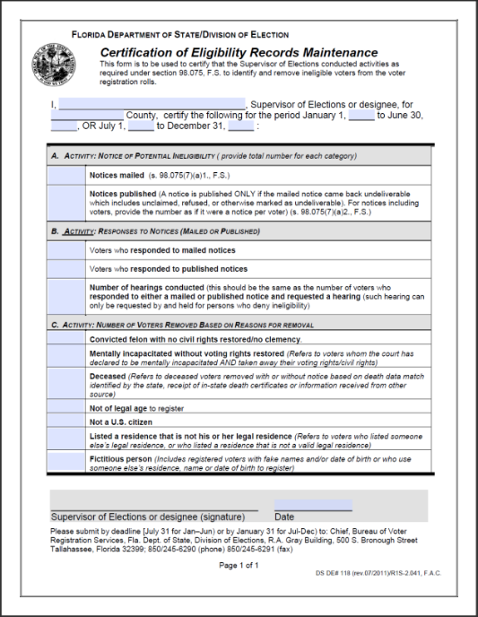
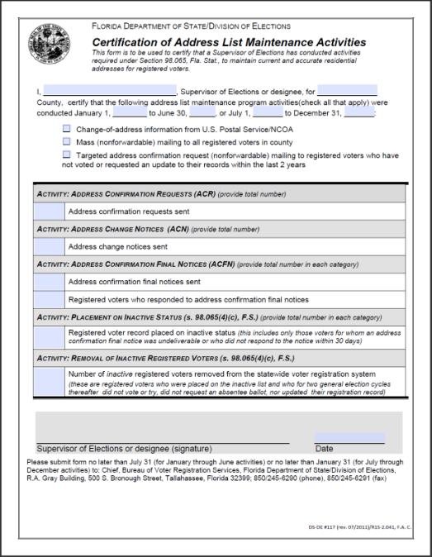
Accounting-Eligibility and
Address Records Maintenance
Bi-annual 6-month certification of activities reports (due no later than July 31 and January 31 every year-documents SOEs maintenance record activities relating to address changes, updates and requests for confirmations, and eligibility)

Slide 31
    Reports (Daily, Monthly, Quarterly, Annually)

Slide 32
Daily Reports
Move-in/move-outs of potential felons within county:
  If file created in BVRS, contact BVRS so match can be re-evaluated for continuing validity
    If still valid, BVRS will be re-assigned to the new county of residence
    Do not ignore
    You can notify the other county but BVRS must be notified as well.
  If file is created in the county, then the SOE MUST notify the new county and coordinate file transfer
    Do not involve BVRS

Slide 33
Daily Reports (cont’d)
Protected records
  Compare this report to the prior generated report to determine if the protected flag on any of these records have been removed and are no longer protected in FVRS.
Administrative data input cross-checks [ongoing and/or future]

Slide 34
Monthly Reports
  Voter records with birth years older than 115 for subsequent review
  Voters with future and pre-1900 registration dates
  Incorrect SSN information.
    For example, SSN appears in voter record as 082-02-0000 or a five digit SSN 08202
  Incomplete driver’s licenses
    Date of birth less than registration date
    Age in DL is different than voters DOB

Slide 35
Monthly Reports (cont’d)
Supervisor’s and their staff can run these types of reports locally to identify potential errors
Example: Search by address
  If you get a return of 7 or more registered voters at the same address do a crosscheck to see if it is an apartment building, group home, single family home or an address of an appointed guardian
  Follow-up with the voters or guardian may be necessary

Slide 36
Annual Reports
  NONE fields
    All VIDs with the first and last name of NONE or (NONE)
    All where VIDs last name is NONE or (NONE)
    All where VIDs first name is listed as NONE or (NONE)
    All VID records that have blanks in the first/last name fields as well as the word ‘Unknown’
  Incomplete voter status for 2 + years (other than ‘unverifieds’)
  Removal of inactive voters after 2 general election cycles

Slide 37
Aged Reports
The SOE File Utility/FVRS Aged Matches contains the following reports that have not been downloaded by your office:
  DOC Felon Pending Greater than 120 days
  FDLE Felon Pending Greater than 120 days
  Deceased SSA Pending Greater than 7 days
  Deceased BVS Pending Greater than 7 days
  All Pending Death Matches
  All Pending Felon Matches
  Duplicate Matches

Slide 38
Aged and Pending Reports (cont’d)
SOE Portal Applications can be found at: https://soeadminservices.floridados.gov/
Search for Voter Registration/Aged FDLE Felon/Death Match Report
  Check aged reports daily (e.g., deaths, duplicates and felons)
  Check the pending reports (e.g., matches that have not met the 7 day or 120 day timeframe. Find matches through your FVRS notifications.)
Email reminders sent weekly to SOEs to review and act on aged matches
If you are unable to see the match or the voter has moved to a new county, please email BVRSHelp.
RECORD all and whatever action taken including final determination in FVRS

Slide 39
    Contact Information
Bureau Chief:
Toshia Brown - Toshia.Brown@dos.myflorida.com; 850-245-6225
Senior BVRS Supervisor
Tiffany Morley - Tiffany.Morley@dos.myflorida.com; 850-245-6248
Administrative Assistant
Dallas Brown – Dallas.Brown@dos.myflorida.com; 850-245-6122

Slide 40

FLORIDA
DEPARTMENT
of STATE
For more information, visit us online at:
dos.myflorida.com/elections

